Slide 1
INT222 - Internet Fundamentals
Week 10: DOM and Events

Slide 2
Agenda
Document Object Model
DOM Tree, Node
DOM Events

Slide 3
The Document Object Model (review)
The Document Object Model (DOM) is an 2-way application programming interface (API) for HTML (and XML) documents.
It defines the way how the document structure, style and content ca be accessed and manipulated.
It provides a structured representation of the document.
With the DOM, programmers can build documents, navigate their structure, and add, modify, or delete elements and content using JavaScript or other languages.

Slide 4
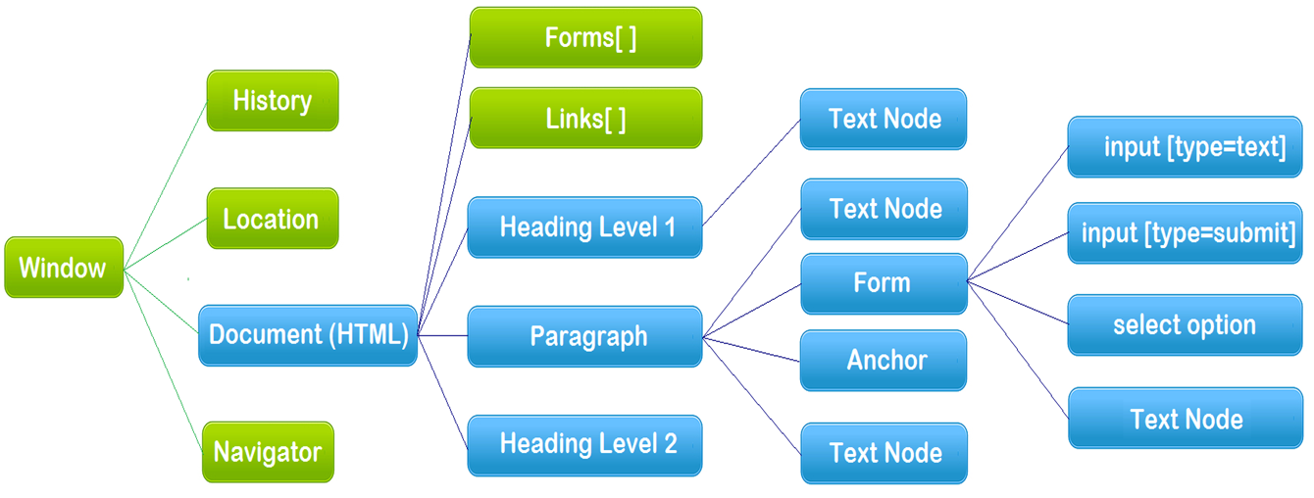
The Document Object Model (DOM)
The hierarchy of Document Object Model (the blue color part)

Slide 5
The DOM tree
<html>
<head>
<meta charset="UTF-8" />
<title>This is a Document!</title>
</head>
<body>
<h3>Welcome!</h3>
<p>This is a paragraph.</p>
<p>This is a paragraph with a
<a href="index.html">link</a> in it.
</p>
<ul>
<li>first item</li>
<li>second item/li>
<li>third item/li>
</ul>
</body>
</html>
When a HTML document is loaded, the browser creates a Document Object Model.
The DOM represents a document as a tree.

Slide 6
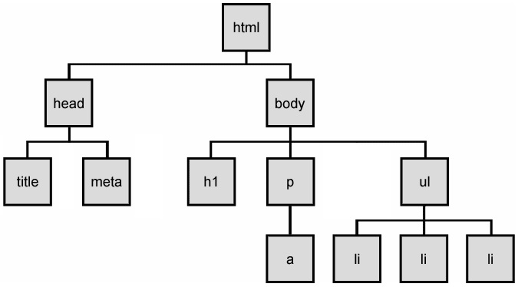
The DOM tree
The HTML elements of the page are nested into a tree-like structure of objects.
The tree is made up of nodes with parent-child relationships. A parent element can have one or many children element(s).
dom-tree.html

Slide 7
HTML DOM Nodes
A document is a structure of nodes (node objects).
Everything in an HTML DOM is a node.
The document (html element) is a document node.
Each element is a node,
All attributes and text inside/of elements are nodes,
DOCTYPE, comments, whitespaces are also nodes.
All these DOM objects inherit form node object, providing Web API - properties and methods
DOM document object
DOM Element objects
DOM Attribute objects
DOM Event object

Slide 8
Types of DOM nodes
element nodes (HTML tag)
For each HTML element, there is a node object.
It can have children and/or attributes
text nodes (text in a block element)
attribute nodes (attribute/value pair)
text/attributes are children in an element node
cannot have children or attributes
not usually shown when drawing the DOM tree

Slide 9
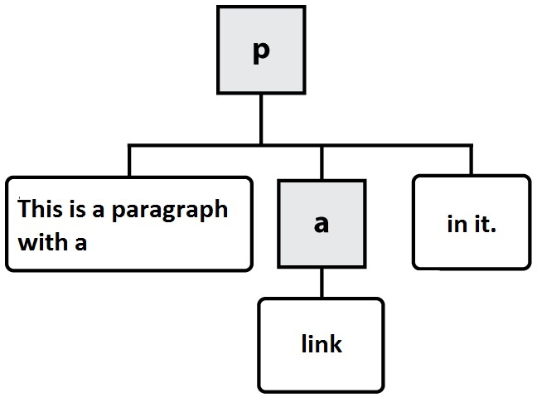



Types of DOM nodes - example
HTML
DOM nodes
element nodes
text nodes
attribute nodes
Note: A DOM tree does
not end at element nodes!
<p>This is a paragraph with a <a href="index.html">link</a> in it.</p>

Slide 10
Traversing the DOM tree
Every node's DOM object, which inherit from Node object, has the following properties:
name(s) | description
firstChild, lastChild | start/end of this node's list of children
childNodes | array of all this node's children
nextSibling, previousSibling | neighboring nodes with the same parent
parentNode | the element that contains this node

Slide 11
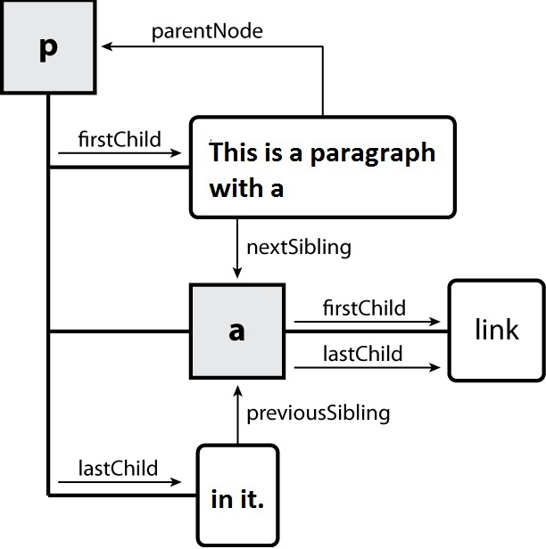
DOM tree traversal example
dom-traversal.html

Slide 12
The HTML DOM Element Object
When an HTML element is loaded into a browser, an HTML DOM Element object in created.
DOM Element object (as node) provides standard API with properties and methods of:
Properties:
Methods:
The HTML DOM Element Object
element.className
element.id
element.style
element.innerHTML
element.parentNode
element.lastChild
element.nextSibling
… …
element.getElementsByTagName()
element.getElementsByClassName()
element.querySelector()
element.querySelectorAll()
element.addEventListener()
element.appendChild()
element.insertBefore()
element.removeChild()
element.setAttribute()
element.getAttribute()

Slide 13
Example
HTML
JavaScript
<p>Mail to: </p>
<div id="address">
<p>70 The Pond Road</p>
<p>Toronto, ON</p>
</div>
var elem = document.getElementById("address").;
var addrParas = elem.getElementsByTagName("p");
// highlight all paragraphs inside of the section with ID "address":
for (var i = 0; i < addrParas.length; i++) {
addrParas[i].style.backgroundColor = "yellow";
}
node-elements.html

Slide 14
Modifying DOM with JavaScript
Modifying HTML Structure and content with JavaScript

Slide 15
Creating New Nodes
name | description
document.createElement("tag") | creates and returns a new empty DOM node representing an element of that type
document.createTextNode("text") | creates and returns a text node containing given text
merely creating a node does not add it to the page
you must add the new node as a child of an existing element on the page...
e.g.
// create a new <h2> node
var newHeading = document.createElement("h2");
var t = document.document.createTextNode(" This is a heading ");
newHeading.appendChild(t);
newHeading.style.color = “blue";

Slide 16
Modifying the DOM tree
Every DOM element object has these methods:
e.g.
name | description
appendChild(node) | places given node at end of this node's child list
insertBefore(new, old) | places the given new node in this node's child list just before old child
removeChild(node) | removes given node from this node's child list
replaceChild(new, old) | replaces given child with new node
node_appendChild.html
node_insertBefore.html
node_removeChild.html
node_replaceChild.html

Slide 17
Modifying element / node attributes
DOM nodes provide access to HTML attributes using the following standard methods:
e.g.
node-setAttributes.html
name | description
hasAttribute(name) | checks if the attribute exists
getAttribute(name) | gets an attribute value
setAttribute(name, value) | sets an attribute
removeAttribute(name) | removes an attribute
var d = document.getElementById("d1");
d.setAttribute("class", "notes");
// or simply:
// s.class = "notes";

Slide 18
DOM versus innerHTML
innerHTML e.g.
innerHTML
bad style on many levels (e.g. JS code embedded within HTML)
error-prone: must carefully distinguish " and '
can only add at beginning or end, not in middle of child list
document.getElementById(“elem”).innerHTML +=
"<p style='color: red; " +
"margin-left: 50px;' " +
"onclick='myOnClick();'>" +
"A paragraph!</p>";

Slide 19
Example - Using the DOM Table Interface
<table id="table0">
<tr> <td>Row 0 Cell 0</td> <td>Row 0 Cell 1</td></tr>
</table>
<script>
function add() {
var table = document.getElementById('table0');
var row = table.insertRow(-1);
var cell, text;
for (var i = 0; i < 2; i++) {
cell = row.insertCell(-1);
text = 'Row ' + row.rowIndex + ' Cell ' + i;
cell.appendChild(document.createTextNode(text));
}
}
</script>
dom-table.html

Slide 20
Modifying DOM with JavaScript
Modify CSS formatting and appearances

Slide 21
Changing HTML style with JS
Approach 1: Using HTML DOM Style Object
Corresponding style property of HTML elements,
allows you set any CSS style for an element.
Syntax:
element.style.property =“new style;”
element.style =“new styles;”
e.g. highlight all paragraphs in the document
var allParas = document.getElementsByTagName("p");
for (var i = 0; i < allParas.length; i++) {
allParas[i].style.backgroundColor = "yellow";
// allParas[i].style = "color: red; font-size: 70px;";
}

Slide 22
HTML DOM Style Object
Style Object Properties
Property | Description
backgroundColor | Sets or returns the background-color of an element
border | Sets or returns borderWidth, borderStyle, and borderColor in one declaration
borderColor | Sets or returns the color of an element's border (can have up to four values)
color | Sets or returns the color of the text
display | Sets or returns an element's display type
fontSize | Sets or returns the font size of the text
fontWeight | Sets or returns the boldness of the font
margin | Sets or returns the margins of an element (can have up to four values)
padding | Sets or returns the padding of an element (can have up to four values)
textDecoration | Sets or returns the decoration of a text
minHeight | Sets or returns the minimum height of an element
minWidth | Sets or returns the minimum width of an element
visibility | Sets or returns whether an element should be visible

Slide 23
Changing HTML style with JS
Approach 2:
element.setAttribute("style", new styles);
e.g.
var elem = getElementById(“xy1”);
// set multiple style properties in one statement
elem.setAttribute(“style”, “width:200;background:blue;”);
Approach 3:
element.setAttribute(“class", class name);
// or: element.className = class name;
e.g.
var elem = getElementById(“xy1”);
elem.setAttribute(“class”, “myclass”);
// or: elem.className = “myclass”;

Slide 24
HTML DOM Events

Slide 25
Events
In general everything that happens in a browser may be called an event.
e.g. an event occurs when a user clicks on a link or a button in a form
Every element on a web page has certain events which can trigger a JavaScript function.
JavaScript needs a way of detecting user actions so that it knows when to react.
It also needs to know which functions to execute.

Slide 26
Common Events
Events triggered by user actions.
e.g.
When a user clicks the mouse
When a user strokes a key
When the mouse moves over an element
When an input field is changed
When an HTML form is submitted
Events that are not directly caused by the user.
e.g.
When a web page has finished loading
When an image has been loaded
Events category
Mouse events, keyboard events, HTML frame/object events, HTML form events, user interface events, touch events, …

Slide 27
Event Handlers
Event Handlers are used to manipulate documents.
An event handler is used in order to execute a script when an event occurs.
The event handler has a prefix "on" followed by the event name.
For example, the event handler for the click event is onclick.

Slide 28
Event Handlers
Event handlers are divided into:
Interactive event handler An interactive event handler depends on the user doing something to a document
such as moving a cursor over an object.
Non-interactive event handler A non-interactive event hander execute automatically depending on events
such as onload.

Slide 29
Event Handler Examples
Using event handlers to change the elements of a document by
writing a line of code in the value of the event handler
writing a JavaScript function in a <script> element, then calling the function from the event handler
<input type="button" name="MyButton" value="New Button!"
onclick="window.open('mywindow.html', 'MyWin')" />
<input type='checkbox' name='system_type' value='4'
onclick='commonSense()'/>Unix

Slide 30
Creating Event Handler
To create an event handler for an HTML tag:
add the event handler attribute to the tag.
write the JavaScript code in quotation marks as the attribute value..

Slide 31
Creating Event Handler
The general syntax is
<htmltag id="xyx01" eventHandler="JavaScript Code">
htmltag - an HTML tag/element
eventHandler - the name of the event handler
JavaScript Code - a set of JavaScript statements.
For good coding style, put event handler in JavaScrip code/file, e.g.

Slide 32
Creating Event Handler
Notes:
The event handlers in HTML must be enclosed in quotation marks.
Alternate double quotation marks with single quotation marks:
e.g.
You can also use \' or \" to achieve the same result.
<input type="button" name="MyButton" value="New Button!"
onclick="alert('some text')" />
<input type="button" name="MyButton" value="New Button!"
onclick="alert(\"some text\")" />

Slide 33
Using the HTML DOM
The HTML DOM allows you to create the event object to the element using JavaScript
better coding style: separation of structure and behaviour
window.onload = function() { // why use window.onload?
var elem = document.getElementById("myBtn");
//elem.onclick = displayDate;
elem.addEventListener( "click", displayDate );
}
function displayDate() {
document.getElementById("demo").innerHTML
= (new Date()).toLocaleString();
}
js-event-init.html

Slide 34
Event Handler Examples
onchange:
occurs when the content of a field changes.
Applies to :
select, text, input elements
Example:
js_onchange.html

Slide 35
Event Handler Examples
onclick
Occurs when the user has pressed and released a mouse button (or keyboard equivalent) on an element.
Applies to:
button, document, checkbox, link, radio, reset, submit
Example:
js_onclick.html

Slide 36
Event Handler Examples
ondblclick
Occurs when the user has double-clicked a mouse button on an element.
Applies to the following HTML tags:
document, image button elements, link
Example:
js-ondblclick.html

Slide 37
Event Handler Examples
onfocus
Occurs when the user has given focus to an element.
Applies to
button, checkbox, file, password, radio, reset, select, submit, text, textarea, window.
Example:
js-onfocus.html

Slide 38
Event Handler Examples
onload
Occurs when a document or other external element has completed downloading all data into the browser.
Applies to
image, window.
Example:
js-onload.html
js-onload2.html

Slide 39
Event Handler Examples
onmouseout
Occurs when the user has rolled the mouse out of an element.
Applies to
image, window.
Example:
js-onmouseout.html

Slide 40
Event Handler Examples
onmouseover
Occurs when the user has rolled the mouse on top of an element.
Applies to
image, window.
Example:
js-onmouseover.html

Slide 41
Event Handler Examples
onresize
Occurs when the user has resized a window or object.
Applies to
window.
Example:
js-onresize.html

Slide 42
HTML onbeforeunload Event
onbeforeunload
The onbeforeunload event fires when the document is about to be unloaded.
js-onbeforeunload.html

Slide 43
Timer Events
method | description
setTimeout(function, delayMS); | arranges to call given function after given delay in ms
setInterval(function, delayMS); | arranges to call function repeatedly every delayMS ms
clearTimeout(timerID); clearInterval(timerID); | stops the given timer so it will not call its function
The first 2 methods return timerID which can be used to stop the timer by using the last 2 methods.
E.g.
<button onclick="setInterval(function(){alert('Hello')},3000);">
Try it</button>
<!-- this code alert “hello” every 3 seconds. -->

Slide 44
Resourceful Links
MDN: Introduction to DOM
MDN: DOM Examples
MDN: Creating New Elements
JavaScript Kit: DOM Reference
W3C: Handling events with JavaScript

Slide 45
Thank You!

